Slide 1
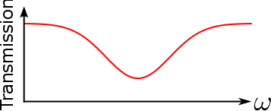
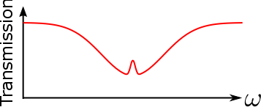
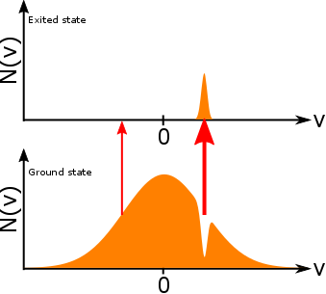
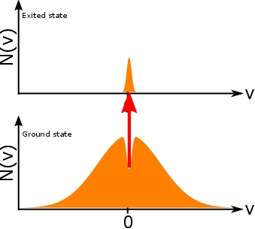
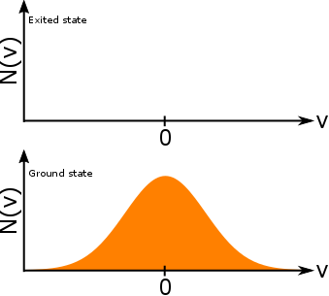

Saturated absorption spectroscopy
Absorption coefficient $κ\left(ω\right)=∫\left(N_{1}\left(v\right)−N_{2}\left(v\right)\right)σ\left(ω−kv\right)dv$
Only one exited state within doppler width:
Probe only
Pump + Probe

Slide 2
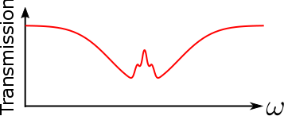
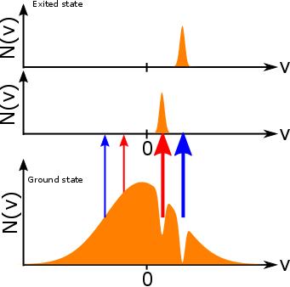
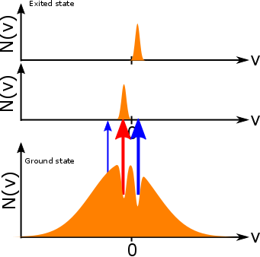
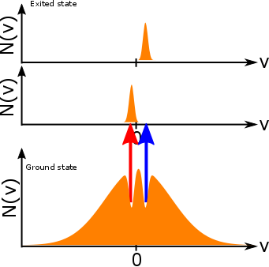

Saturated absorption spectroscopy
Absorption coefficient $κ\left(ω\right)=∫\left(N_{1}\left(v\right)−N_{2}\left(v\right)\right)σ\left(ω−kv\right)dv$
Two excited states within Doppler width:

